Slide 1
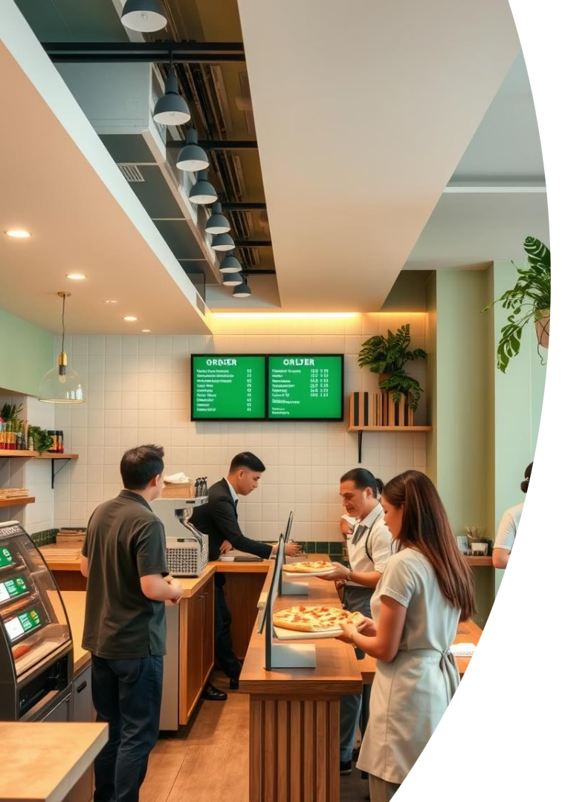
Pizza Shop Management System
Data Structures and Algorithms Made by Rimsha Jawad CMS ID 385345 BEE-13-B

Slide 2

Project Overview
Complete System
Core Data Structures
Manages orders and customers including Walk-In, Dine-In, and Home Delivery.
Used for order processing, customer service, route calculation, and billing.
Statistics & Logs
Maintains customer service records and delivery charge details.

Slide 3
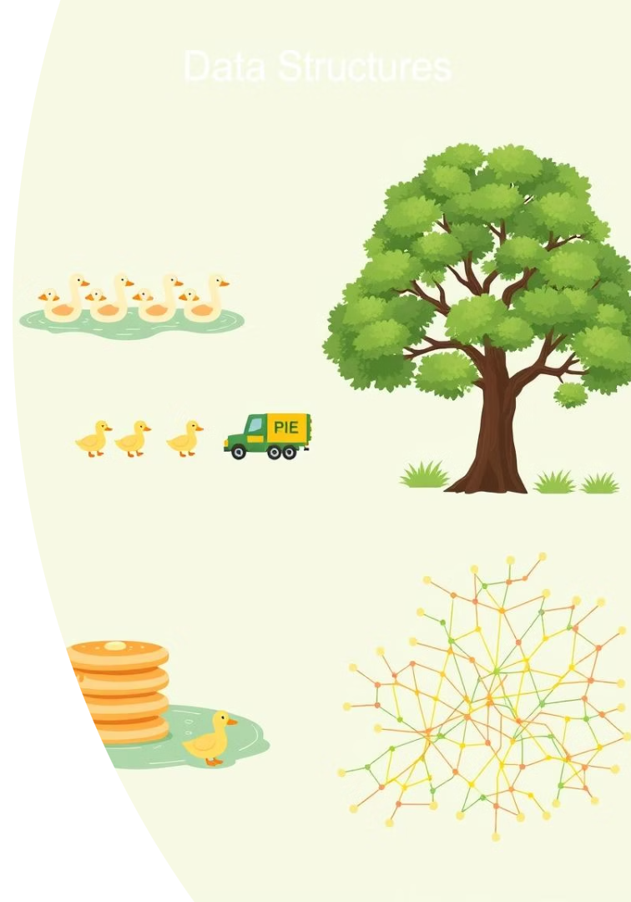
Project Objectives
Serve Customers
Using priority rules: Age-based, FCFS, and LIFO methods.
Record Keeping
Store and retrieve served customer records efficiently.
Efficient Delivery
Calculate delivery charges via Dijkstra's shortest path algorithm.
Demonstrate DSA
Implement Priority Queue, Queue, Stack, AVL Tree, and Graphs in practice.

Slide 4

Customer Categories & Serving Logic
Customer Type
Serving Order
Data Structure
Walk-In
Older first
Dynamic Priority Queue
Home Delivery
Last-In-First-Out
Stack
Dine-In
First-Come-First-Serve
Dynamic Queue

Slide 5
Data Structures Used
Linked List
Priority Queue
Queue
Stack
Base container for queues and stacks managing orders.
Supports age-based sorting for Walk-In customers.
Controls FCFS order for Dine-In customers.
Handles LIFO order for Home Delivery customers.
Graph enables routing. AVL Tree logs and searches customer records.

Slide 6
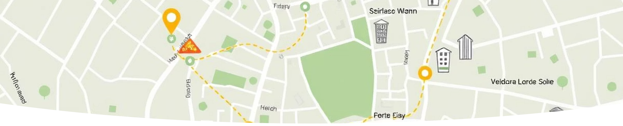
Graph-Based Delivery System
Delivery Points
Delivery Charges
Algorithm
Shop, Chauburji, Shadman, Islampura, Johar Town, and Anarkali.
Rs. 50 per kilometer based on shortest path.
Dijkstra’s Algorithm computes efficient delivery routes.

Slide 7
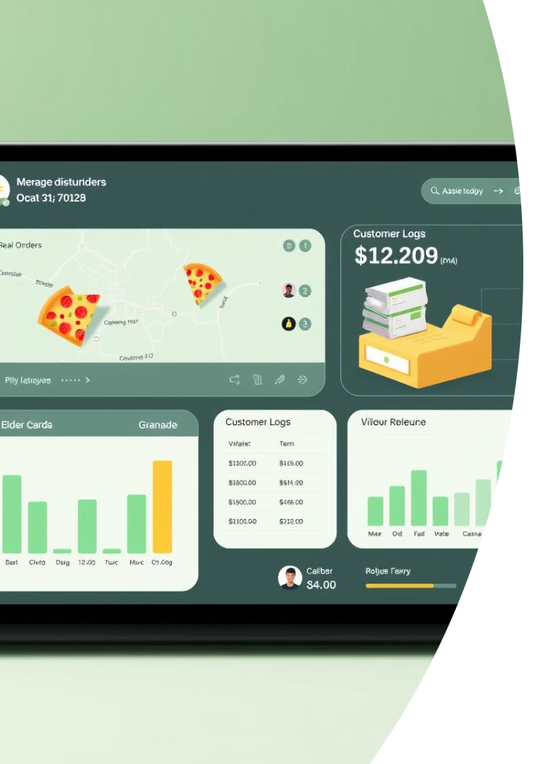
Key Features
Order Management
Add, serve, and remove customers seamlessly.
Billing
Calculate bills with accurate delivery charges.
Customer Logs
Track served customers using AVL tree for quick search.
Status Displays
Show pending and served orders with earnings summary.
Menu options and prices provided within the system.

Slide 8
Algorithms & Logic
Priority Serving
Shortest Path
AVL Tree Operations
Real-time Updates
Custom age-based sorting for Walk-In customers.
Dijkstra's algorithm operates on adjacency lists efficiently.
Balanced insertions, deletions, and fast searches for logs.
Dynamic state management of queues, stacks, and customers.

Slide 9
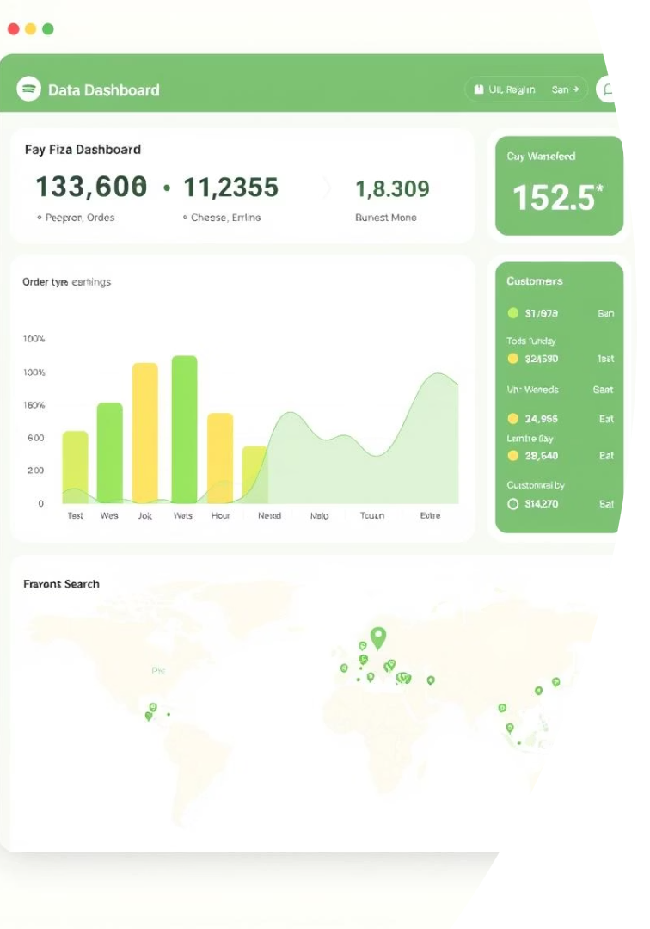
Insights Provided
Financial Overview
Order Status
Total daily earnings from all processed orders.
Breakdown of pending orders and associated bills.
Customer Records
Historical served customers stored and searchable lexicographically.

Slide 10

Benefits & Applications
Customer Service
Improved efficiency via data structure-driven management.
Cost Reduction
Shortest-route calculations minimize delivery expenses.
Educational Tool
Practical C++ implementation of core data structures.
Business Modeling
Real-world example of service-based business optimization.

Slide 11
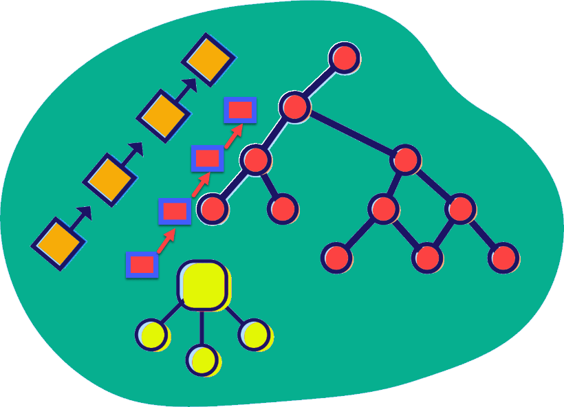
Conclusion
“A smart Pizza Shop is a fast Pizza Shop.” This project showcases how data structures and algorithms can power intelligent service operations and real-time customer management.

